Slide 1

Maximizing Product Selection
Welcome to the world of e-commerce, where product selection is key
BY Madhavan S - 192210580

Slide 2

Understanding Customer Preferences
Understanding customers is vital to success.
1
Customer Research
2
Purchase History
Analyze past purchases to identify trends.
Gather data through surveys, interviews, and feedback.
3
Product Reviews
4
Social Media Monitoring
Collect valuable insights from customer reviews.
Track customer sentiment and conversations.

Slide 3
Analyzing Market Trends
Stay ahead of the curve by analyzing market data.
Industry Reports
Competitive Analysis
Consumer Behavior
Consult industry reports to identify growth areas.
Track competitors' product offerings and strategies.
Monitor shifts in consumer behavior and preferences.

Slide 4

Leveraging Data-Driven Insights
Use data insights to inform your product selection decisions.
Product Popularity
Customer Feedback
Identify top-performing products based on sales data.
Use customer feedback to improve product offerings.
Seasonal Trends
Optimize inventory based on seasonal fluctuations.

Slide 5

Optimizing Product Assortment
Build a well-rounded and diverse assortment of products.
1
Product Categories
Determine the core product categories.
2
Product Variety
Offer a range of choices within each category.
3
Product Attributes
Include various attributes to meet customer needs.
4
Price Points
Offer products at different price points.

Slide 6

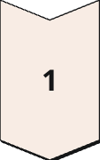
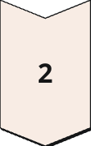
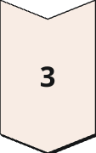
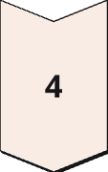
Enhancing Product Discoverability
Make it easy for customers to find what they need.
Search Optimization
Implement robust search functionality.
Category Navigation
Create clear and intuitive categories.
Product Recommendations
Offer personalized product suggestions.
Visual Merchandising
Showcase products in an appealing way.

Slide 7

Time Complexity and Space Complexity
Understand the performance implications of product selection algorithms.
Time Complexity
Space Complexity
The amount of time required to complete an algorithm.
The amount of memory needed to execute an algorithm.
Consider the number of operations involved.
Focus on the data structures and memory usage.

Slide 8





Streamlining Inventory Management
Ensure optimal inventory management for smooth operations.
Real-Time Inventory
Order Fulfillment
Track stock levels in real-time.
Efficiently process orders and shipments.
Automated Reordering
Inventory Analytics
Set up automated reorder points.
Analyze inventory data to identify trends.

Slide 9

Conclusion and Key Takeaways
Successful product selection drives customer satisfaction and business growth.

